Slide 1
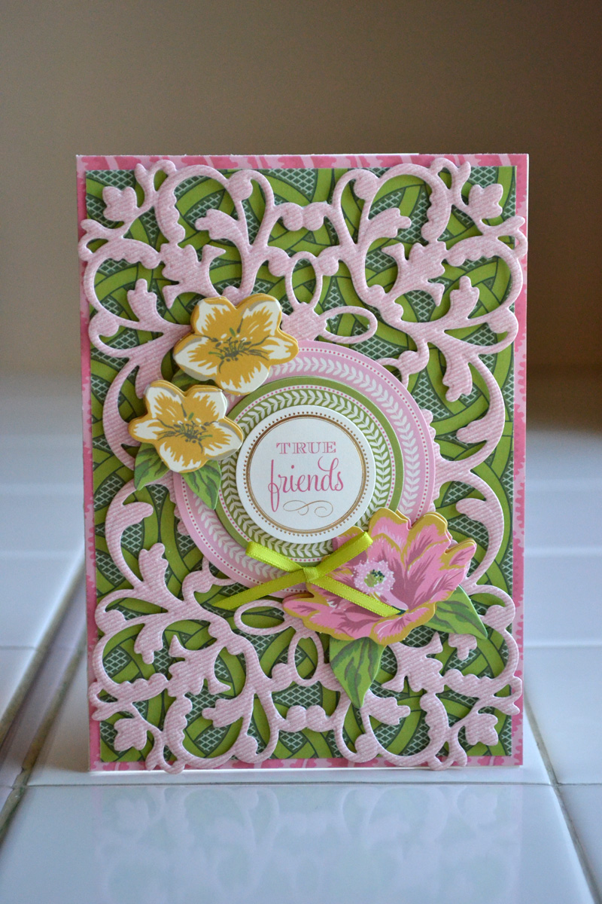
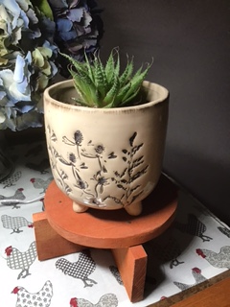
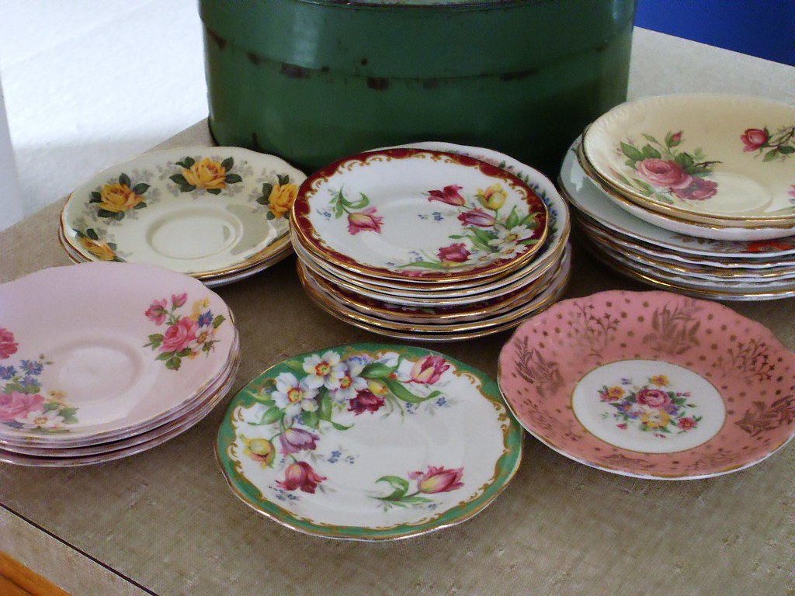
EVENT DETAILS
Craft Saturday Association Day
CONTACT
ERIKA (Group President)
Mobile: 0401 673 842
BOOKING REQUIRED BY NO LATER THAN 13th JUNE
This Photo by Unknown Author is licensed under CC BY-NC-ND
SATURDAY 15 JUNE
CRAFT SATURDAY
ASSOCIATION DAY including lunch at ESTIA HEALTH
Numbers are limited to 20 people.
COST: $25.00 which includes a cooked lunch and morning & afternoon tea.
ADDRESS
Old Schoolhouse,
Estia Health,
879 Plenty Road,
South Morang, 3752
Timber Pot Stands
Whitewashed and ready to assemble, and mosaic top if you wish to.
Creative Memories
An introduction to scrapbooking to create memorable
Family photo albums, and cardmaking.
Decoupage Saucers
Using tissue paper, stickers and glitter transform a plain saucer into a decorative dish to place your jewellery onto.
All Very Welcome! So Book Now to avoid disappointment!
All Very Welcome!
We respect First Nations Elders past, present and future and acknowledge the stories, traditions and living cultures of First Nations peoples of the lands on which our members meet and commit to building a brighter future together.

